Slide 1

Do happier people drink less?
By:
Swati Jadeja

Slide 2
What is our dataset?
The Data Set talks about 123 countries across continents. Information about their Alcohol consumption, happiness Score(as rated by the people) is given.
It also has data about HDI and GDP.

Slide 3
Why This DATA SET?
Hoping to understand the relationship between alcohol consumption and happiness across regions.
Data set is covering information about HDI etc., along with Happiness Score and per capita alcohol consumption.
So, it will give interesting insights into alcohol consumption across different countries as per their development status.
We assume developed countries might have a high per capita alcohol consumption, as well as happiness.
Let’s find out who is happier!

Slide 4
How happy is our world ?
The average happiness score that we get is 5.62. On a scale of 1-10, it is just a moderately happy world.
Now that we know, we live in a moderately happy world let’s find out who are the happiest countries ?

Slide 5
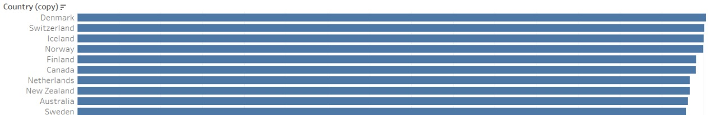
The happiest countries are…

Slide 6
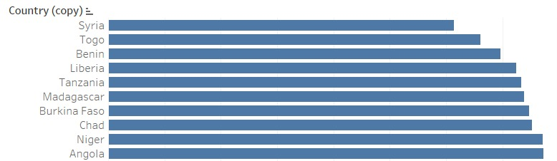
The sad countries are…

Slide 7
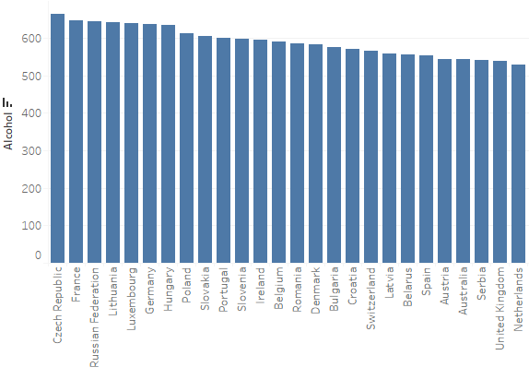
Which countries drink a lot?
Czech Republic
France
Russian Federation
Lithuania
Luxembourg
Germany
Hungary

Slide 8

What is the Happiness situation of Czech republic?
6.852

Slide 9
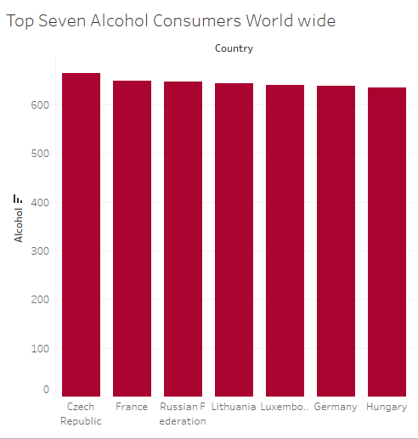
How happy are they?
Country | Happiness Ranking
Luxembourg | 14
Germany | 17
Czech | 20
France | 24
Lithuania | 41
Hungary | 60
Russian Fed | 68

Slide 10
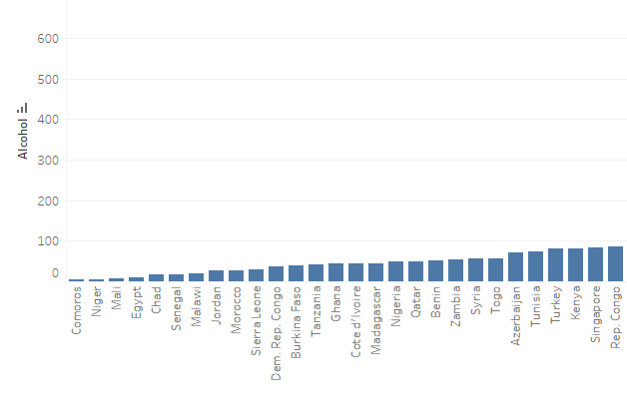
Which countries drink less?

Slide 11

What is the Happiness situation of Comoros?
3.973

Slide 12
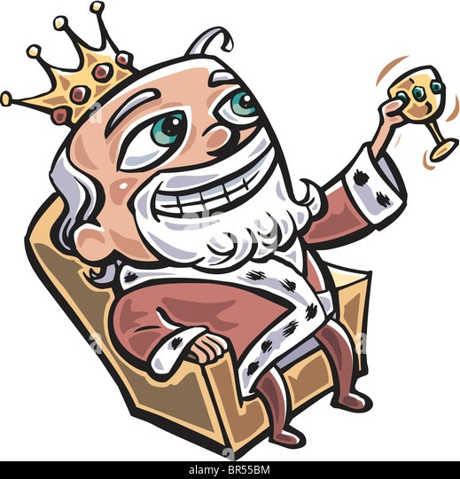
Does high hdi mean higher alcohol consumption ?

Slide 13
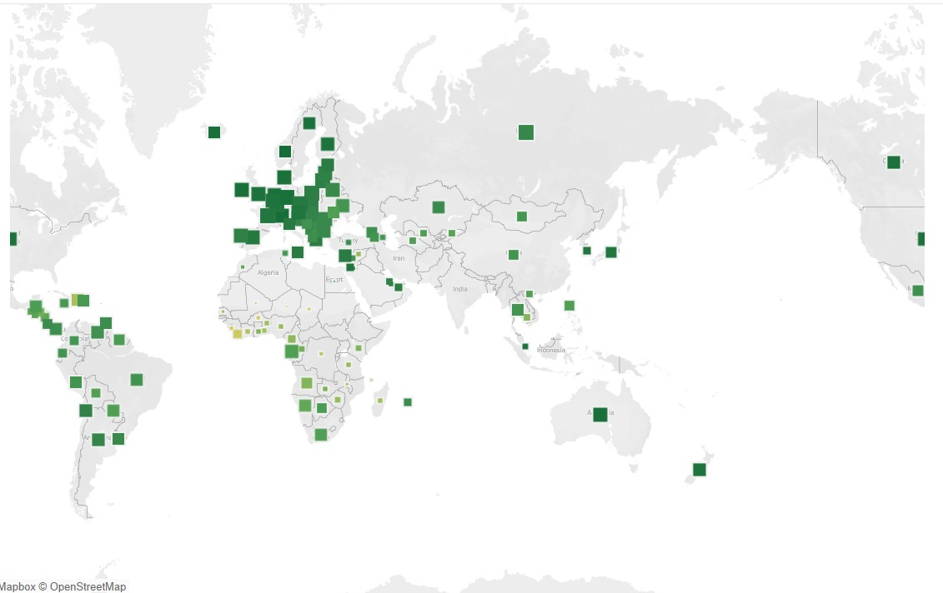
Is this assumption true ?

Slide 14

Are happy countries high on alcohol ?

Slide 15
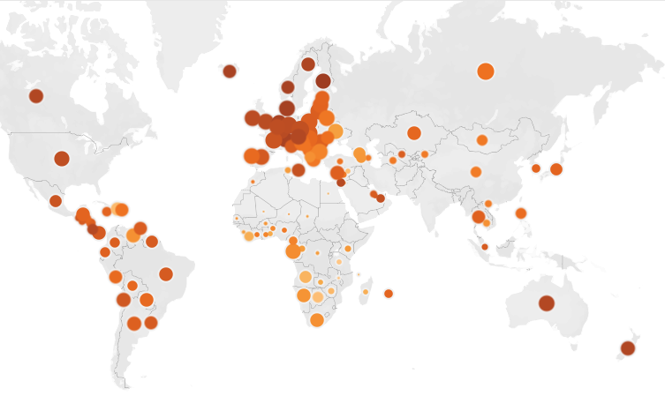
Is this assumption true ?

Slide 16
inference
Some of the happiest countries only have moderate alcohol consumption while some sad countries have an alcohol consumption matching the European region which has the highest consumption levels.
We don’t find any significant relationship between alcohol consumption and happiness.
HDI and alcohol consumption also doesn’t follow a linear pattern.
To conclude we would say that alcohol consumption alone, doesn’t significantly impact happiness. There must be many factors in play apart from alcohol.

Slide 17
THANK you!

